Slide 1






Solving Taxi-v3
by Dilara Özdil
and Yuliya Martyniuk

Slide 2

Introduction
Observation Space
500 discrete states:
25 taxi positions
5 possible locations of the passenger (including when he is in the taxi)
4 destination locations
Action Space
Discrete 6 actions
Reward
- 1 per step unless other reward is triggered.
+ 20 delivering passenger.
-10 executing “pickup” and “drop-off” actions illegally.

Slide 3
.
Q-Learning
Model-free, off-policy RL method
Learns action-value function Q(s, a)
Uses Bellman update rule
Q(s,a)←Q(s,a)+α[r+γamax​Q(s′,a)−Q(s,a)]
The Q-table stores the expected cumulative reward for each state–action pair.
Your paragraph text
Add a little bit of body text
Your paragraph text

Slide 4
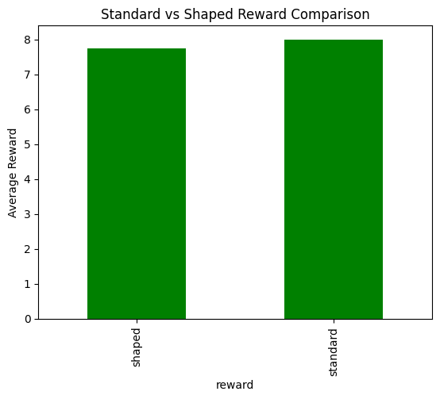
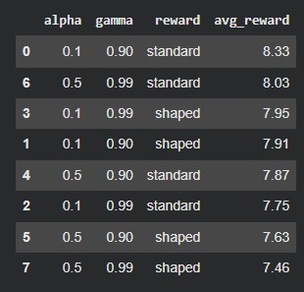
.
Reward Shaping

Slide 5
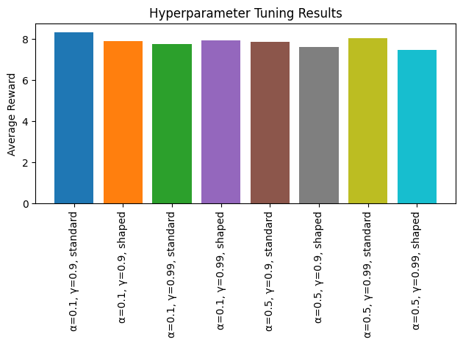
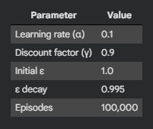
.
Q-Learning
The policy is π(s) = argmaxₐ Q(s,a)
ε-Greedy Exploration
With probability ε → random action
With probability 1 − ε → greedy action
ε decays over time

Slide 6
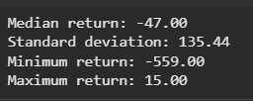
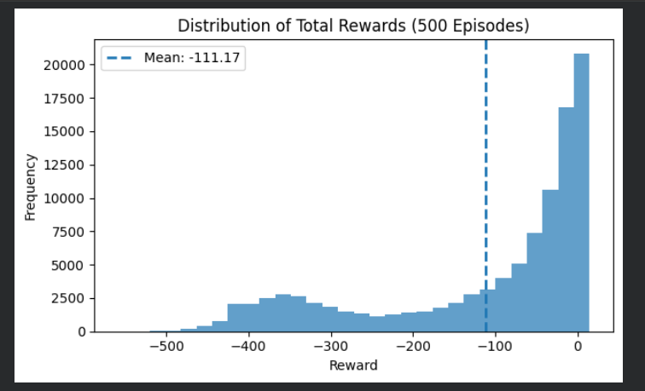
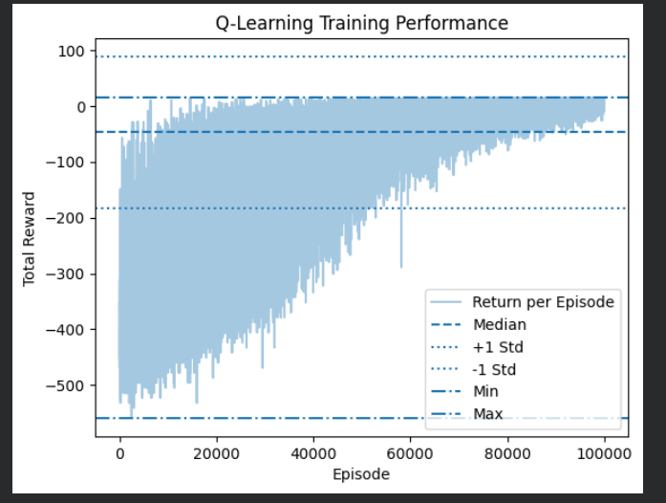
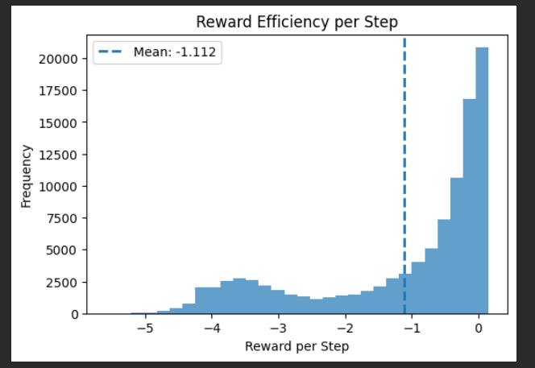
.
Final evaluation

Slide 7
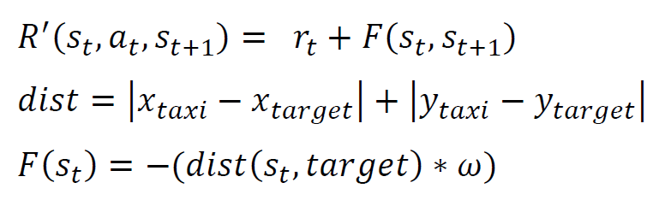
stochastic Policy gradient
Algorithm
REINFORCE (Monte Carlo Policy Gradient)
Neural Network
Input layer: 500-unit vector
Hidden Layers: two fully connecte layers (128 neurons each)
Output layer: 6-unit Softmax layer
Enhanced reward
.

Slide 8
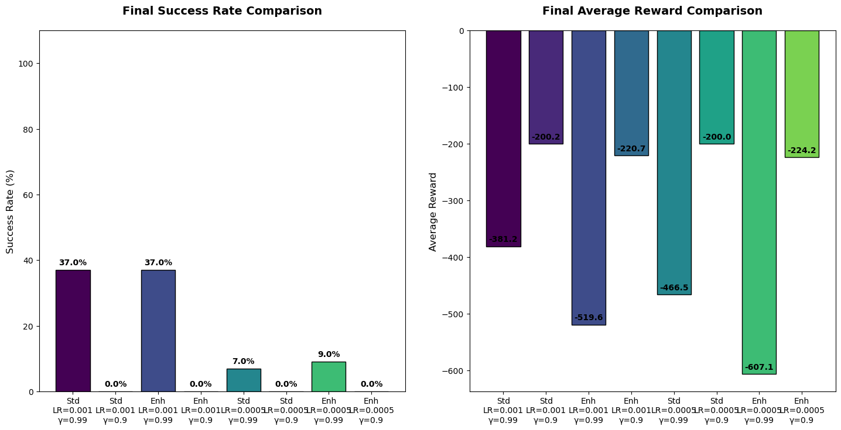
Parameters tuning results
Method
Grid Search over 8 distinct combinations
Parameters
Learning Rate (0.001 vs. 0.0005)
Discount Factor ( 0.99 vs. 0.90)
Reward Models (Standard vs.
Enhanced)
Number of episodes
from 0 to 5000 with 500 step
.

Slide 9
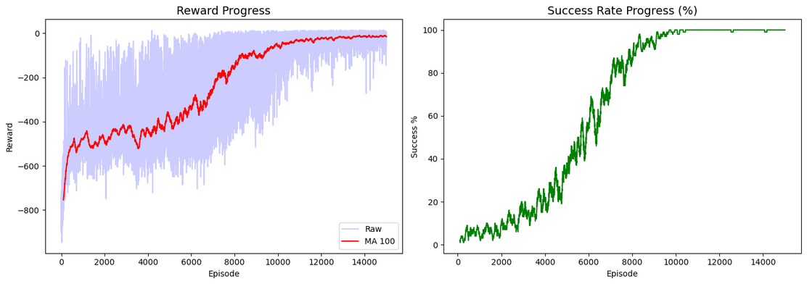
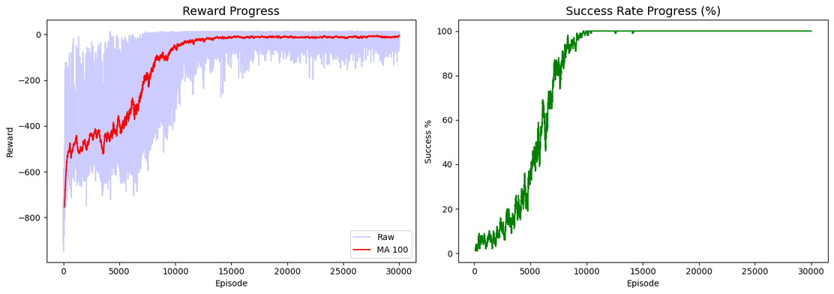
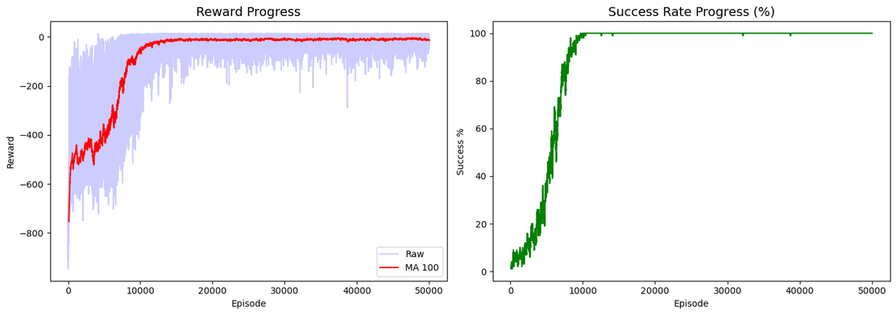
episodes training
parameters | 15k | 30k | 50k | 75k
Mean reward over 100 episodes | -91.40 | -68.41 | -41.49 | -37.11
Success rate | 52% | 63% | 76% | 78%

Slide 10
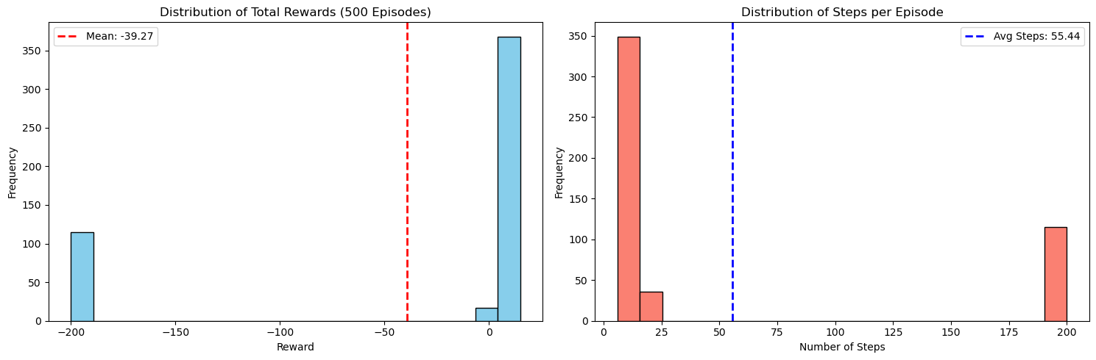
Final evaluation
Results
500 test episodes
Success Rate 77%
Average Reward -39.27
Average Steps 55.44
.

Slide 11
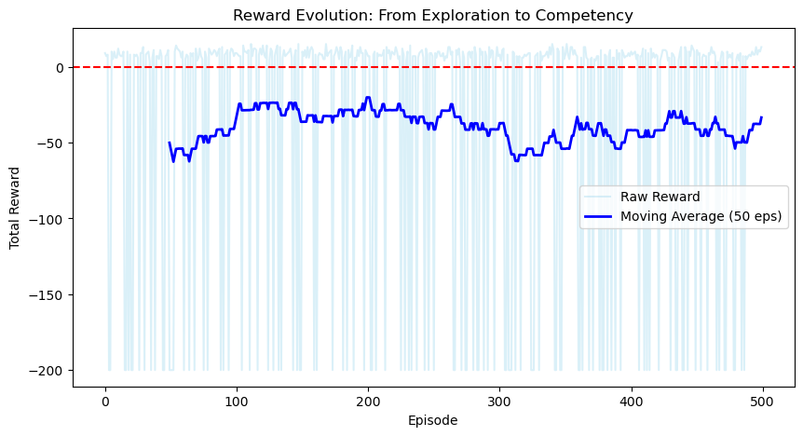
Final evaluation
Results
500 test episodes
Success Rate 77%
Average Reward -39.27
Average Steps 55.44
.

Slide 12


Comparison
Q-Learning
Converges much faster
Updated after every single step and uses "Bellman Equation" to estimate future reward based on the very next state
Positive mean reward (around 7) after 100k episodes
Discount factor 0.9 was effective
Q-table is limited to env where you can fit every state into a table
More stable for Taxi env
Stochastic Policy Gradient
REINFORCE takes longer
Uses Monte Carlo method, it must finish a full episode before it can update its weights
Achieved negative mean reward (-37) with 78% success rate at 75k episodes
Discount factor 0.99 was a must for REINFORCE
Model (using NN) can handle continuous or much larger state spaces
Could suffer from high-variance

Slide 13
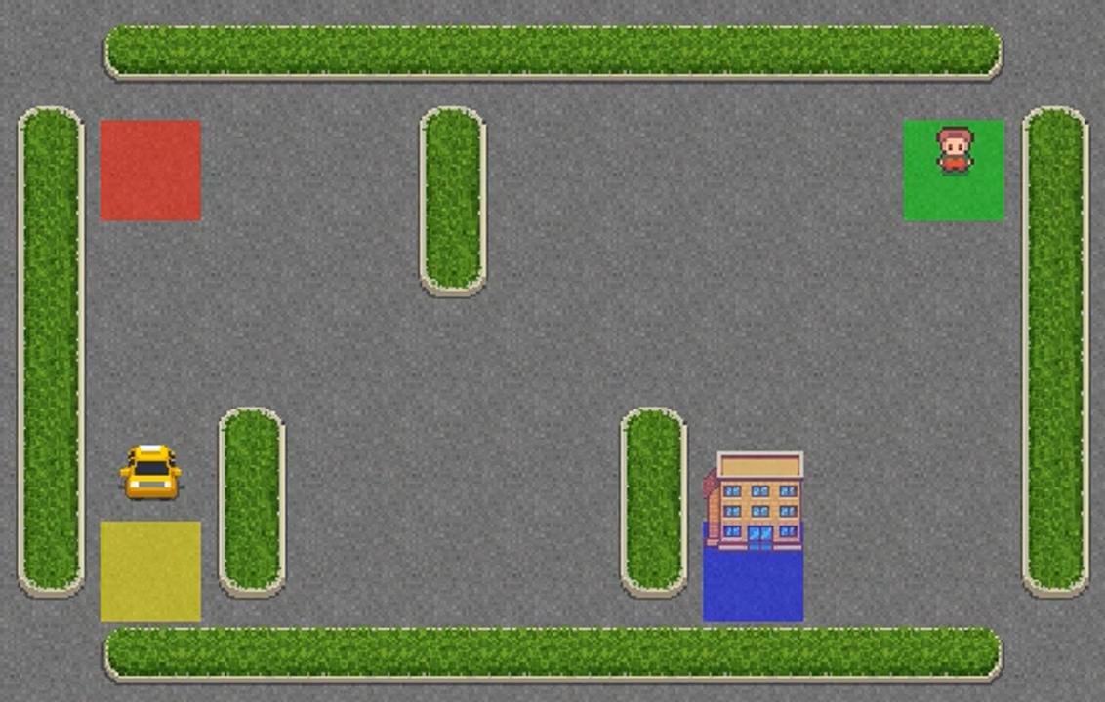
lets see now! Q-learning

Slide 14
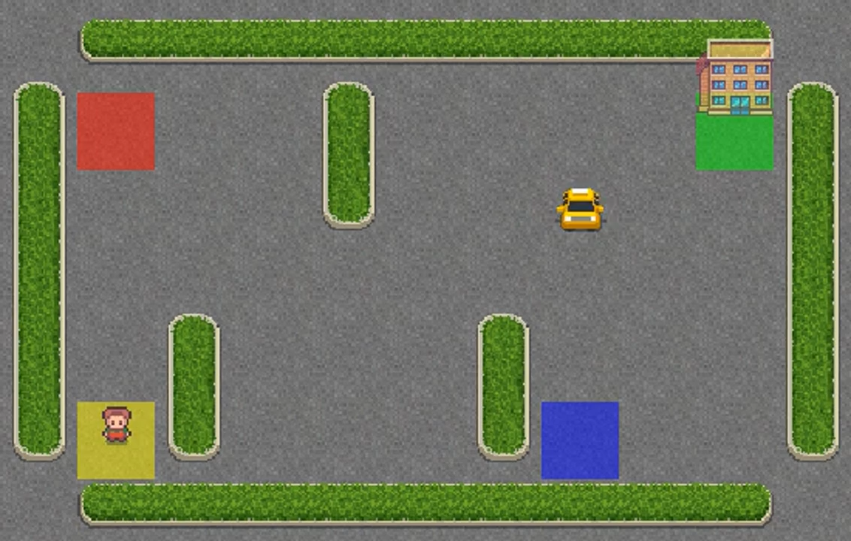
lets see now! Policy gradient

Slide 15



Thank You

